Slide 1
Welcome to .NET 9

Slide 2











Build anything with a unified platform
.NET
Cloud
Web
Desktop
Mobile
Gaming
IoT
AI
+
+
Visual Studio
Visual Studio Code
CLI
GitHub Copilot
Windows
Linux
macOS
NuGet
GitHub
.NET Aspire
Components, tools, library vendors
Tools
Operating system
Ecosystem

Slide 3











.NET Aspire
Official Launch
updates
OpenAI Library for .NET
Commitment to Security
Monthly
Unity for VS Code
Improved GitHub Copilot for .NET
C# Dev Kit
.NET MAUI for VS Code
Ubuntu 24.04
Since Last Year
Virtual Events & Live Streams
NuGet Download Increase
160
45%
Smart Components
.NET Community Toolkit + Native AOT
.NET Aspire Training
NuGet Audit 2.0
Native Library
Interop
Azure AI Inference SDK
.NET 8 Downloads
Over .NET 6
39%

Slide 4




NuGet Fastest Growing Package Ecosystem
Packages
Downloads
Download Increase
420K+
570+ Billion
45%
Security
Features
OpenSSF
Pinned Dependencies
Trusted Publishers
GitHub
Dependabot 2.0
Deps.dev
Support

Slide 5

Loved by developers Trusted by enterprises
6.5+ Million
Monthly active users
60,000+
Community members have contributed to .NET
#1 2024
Most Admired Developer Framework
Top 5
Highest velocity OSS project
Top 5
https://survey.stackoverflow.co/2024/technology/#1-programming-scripting-and-markup-languages
https://survey.stackoverflow.co/2024/technology/#1-web-frameworks-and-technologies
https://survey.stackoverflow.co/2024/technology/#1-other-frameworks-and-libraries
https://github.blog/news-insights/research/the-state-of-open-source-and-ai/#the-most-popular-programming-languages
CNCF (Commits+PRs+Issues)
https://github.com/cncf/velocity/blob/main/reports/top_projects_by_activity.txt
Top Programming Language on GitHub

Slide 6


















.NET powers Microsoft at scale
aka.ms/dotnet-developer-stories

Slide 7

From .NET 6 to .NET 8*
Re-written in C# with .NET 8
From .NET Framework to .NET 8**
35% CPU usage
30% memory consumption
90% smaller codebase
3X​ performance
99.999% reliability on day 1
15% CPU time
13% aggregated core time per query
* Core services that power Microsoft 365
** Services that power Xbox Live

Slide 8































Slide 9


Announcing .NET 9
aka.ms/get-dotnet-9
Productive
Modern & Secure
Intelligent
Performance

Slide 10
.NET 9 Highlights
Productive
Modern & Secure
Intelligent
Performance
.NET Aspire for improved developer inner loop
Deeper GitHub Copilot integration in Visual Studio
Hot Reload enhancements in VS Code with C# Dev Kit
Refreshed build output highlighting
Simplified Blazor authentication
Improved integration with cloud-native services & OpenTelemetry
Enhanced UI controls across Blazor, .NET MAUI, WinUI 3, WPF, and Windows Forms
dotnet restore auditing for known security vulnerabilities
.NET AI Building Blocks with Microsoft.Extensions.AI
AI Tokenizers
Tensor<T>
TensorPrimitives
.NET SDKs for vector databases
Server-Sent Event Parser
Adaptive Garbage Collection
Up to 25% faster Blazor startup
Optimized static web assets
with ref struct improvements
More Native AOT
Trimming optimizations
New NuGet restore resolver for large projects

Slide 11
Most performant release yet
>1000 Performance-related PRs
JSON
Native AOT
JIT
Compression
PGO
ARM64
Bounds Check
ARM SVE
Cryptography
Vectorization
Write Barriers
GC
Threading
Reflection
Object Stack Allocation
Loops
LINQ
Diagnostics
Numerics
Span
Inlining
Networking
https://devblogs.microsoft.com/dotnet/performance-improvements-in-net-9/

Slide 12

.NET Aspire
AI + .NET
.NET MAUI
ASP.NET Core
Developer Productivity

Slide 13



Biggest release of .NET yet

Slide 14
.NET 9 Community
>26k
>9k
Contributions
Community members

Slide 15


Thank You!

Slide 16
Best way to build apps
Modern
Workloads
Web
Client
Artificial Intelligence
Cloud
Developer
Productivity
Language
Libraries
Developer Tools
Modernization
Fundamentals
Observable
Performance
Secure by Design
Resilient
Accessible
Scalable
Manageable

Slide 17
.NET Aspire
Your building blocks for app development

Slide 18
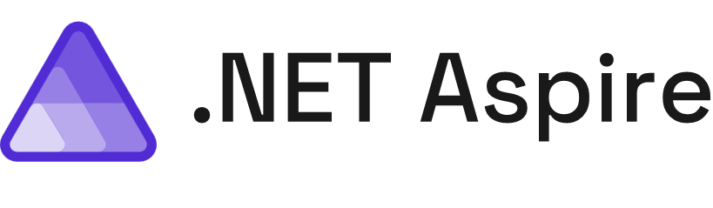
Build, test, and deploy apps seamlessly from code to cloud
Streamlined Inner-Loop
Developer Dashboard
Integrations
Deployment
Extensible, OpenTelemetry Built-in, & Ready for Any Cloud

Slide 19

Get started
To build
To deploy
Open-source
Templates
Integrations
Service discovery
Developer dashboard
Logs, metrics, distributed traces
Single command run
App topology in C#
Cloud deployment

Slide 20
Demo

Slide 21




💖
Announcing
.NET Aspire Community Toolkit
github.com/CommunityToolkit/aspire

Slide 22
💖
Preview
Azure Functions support for .NET Aspire

Slide 23
Demo

Slide 24
“.NET Aspire has really helped us tighten our inner development loop”
Logs
Metrics
Traces
Azure Integrations
Craig Taylor
Principal Architect, XBOX Live

Slide 25

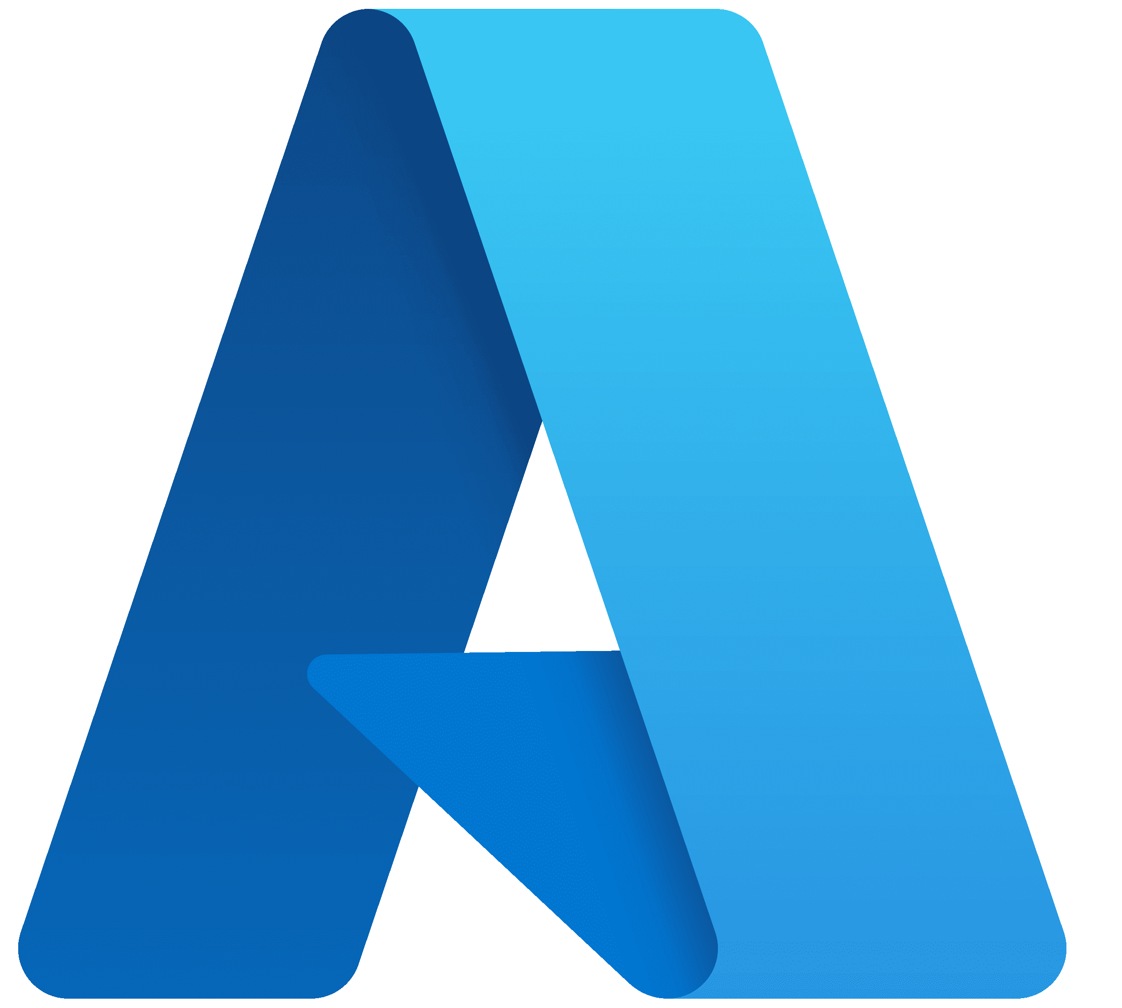



Azure Functions preview support
More secure defaults
“WaitFor” resources to spin up
Start/Stop Resources
Improved
Azure Configuration
Simplified acquisition
.NET Aspire 9.0
Improved Azure Container Apps integration
Persistent
Containers
Visual Studio & C# Dev Kit enhancements
.NET Aspire Community Toolkit
Support for
.NET 8 & .NET 9
OpenAI Integration
AWS Stable Integrations
Tune in at for What’s New in .NET Aspire
9:00am PST

Slide 26
AI
Integrating AI into your .NET app

Slide 27

.NET & AI
Learn
Integrate
Collaborate
Deploy

Slide 28
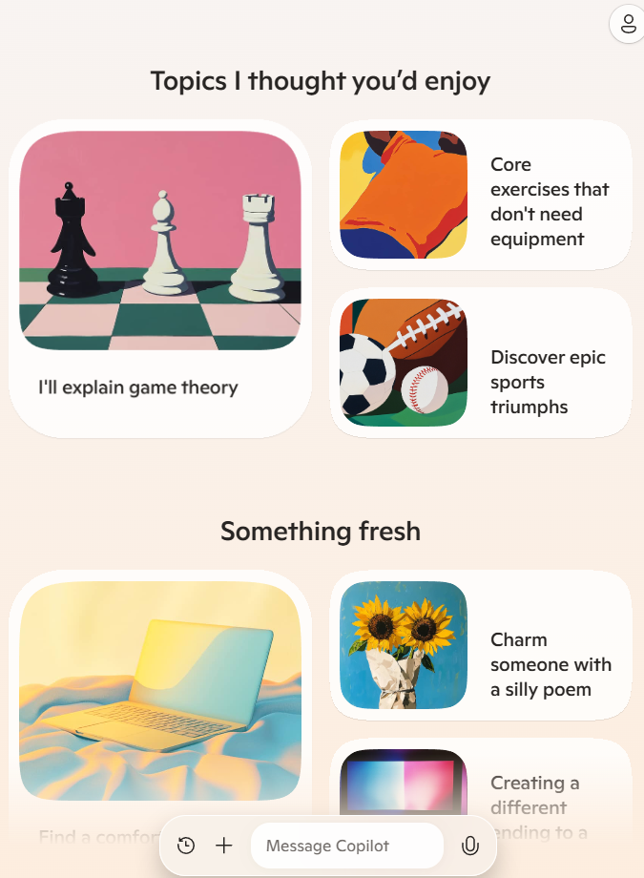
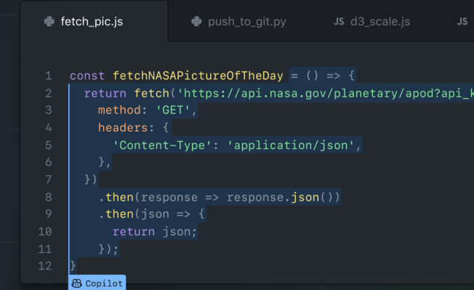
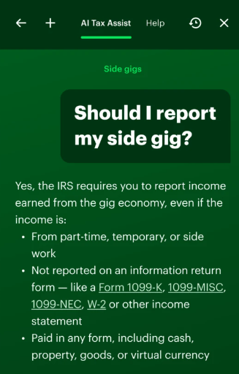

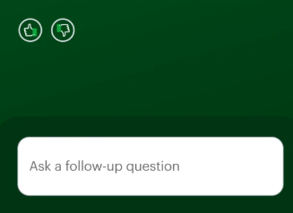

Generative Applications Built on .NET
Microsoft Copilot
GitHub Copilot
H&R Block
Copilot assisted coding

Slide 29

KPMG Clara
“Our .NET stack supported rapid development of these AI features with the language and tools our developers know and love”
- Thomas Mackenzie, Global Audit Chief Technology Officer
KPMG Clara with AI empowers our 95,000 audit professionals to improve audit quality and focus on higher risk areas.
Built with .NET, AI, & Azure

Slide 30














.NET AI Ecosystem
Semantic Kernel
Azure OpenAI
Azure AI Search
Azure Inference
OpenAI library for .NET
LlamaParse C# Client
Qdrant Solutions
C# Client
GitHub Models
C# Client
Smart Components
Smart Components
Smart Components

Slide 31
Microsoft.Extensions.AI .NET AI Library
Streamline AI integration with our unified APIs
Common AI Abstractions
Standard Middleware
Interoperability and Extensibility
Available in Preview Today

Slide 32

PIECES
®
FOR DEVELOPERS
Pieces: an AI productivity toolchain for developers.
“Our team was able to integrate Microsoft.Extensions.AI into our SDK in just a few hours, providing our SDK users a simpler way to integrate the long-term memory of Pieces into their .NET Applications”
Using Microsoft.Extensions.AI

Slide 33
Demo
Microsoft.Extensions.AI
Available in Preview

Slide 34




Azure AI Inference SDK for .NET
TensorPrimitives
Smart Components
AI App Gallery
Microsoft.Extensions.AI
Library Available in Preview Today
.NET and AI
Pinecone
Official .NET Client
.NET Aspire Integrations for AI
Official OpenAI library for .NET
Microsoft Learn Training
New .NET Samples
AI Tokenizers
Tune in at for AI Building Blocks – A new, unified AI layer
9:45am PST

Slide 35
Client App Development

Slide 36





Microsoft’s investments in client development with .NET
Windows Native
Cross Platform Native
Hybrid
Web
WinUI3
.NET MAUI
Blazor Hybrid
WebView2
Blazor Web
WinForms
WPF

Slide 37

.NET Multi-platform App UI (MAUI)
Single project system, single codebase
WinUI
Mac Catalyst
iOS
Android
macOS
iOS

Slide 38
.NET MAUI in .NET 9
Controls
App Lifecycle
Performance
Platform Integrations

Slide 39
.NET MAUI is Active and Growing
>30%
Active users
1600+ PRs,
600+ Issues Closed in .NET 8
1900+ PRs,
2800+ Issues Closed since .NET 8 release
github.com/dotnet/maui

Slide 40
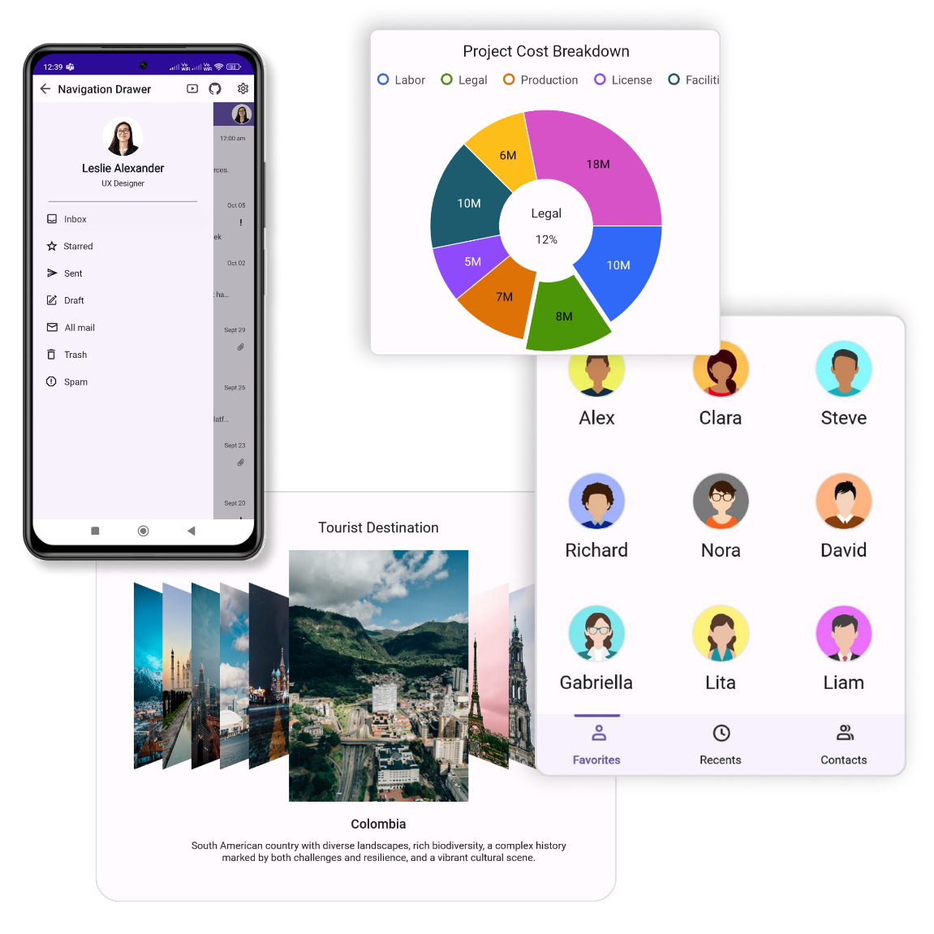

Syncfusion Toolkit for .NET MAUI
14 free, open-source controls available for .NET MAUI!
Open-source on github.com/syncfusion/maui-toolkit
Package Syncfusion.Maui.Toolkit available on NuGet

Slide 41
Demo

Slide 42

































Slide 43



Android 35 & iOS 18 Support
Xcode Sync CLI
Multi-target bindings
Native Library Interop
New lifecycle events
Activate Window
CollectionView & CarouselView Performance Improvements
.NET MAUI in .NET 9
New TitleBar Control
Asset Packs
HybridWeb View
Justify text alignment
Native Embedding Enhancements
New Input Keyboards
Native AOT improvements
Trimming Enhancements
Tune in at for What’s New in .NET MAUI
12:00pm PST

Slide 44
Web Development

Slide 45
ASP.NET Core: Your Full Stack Web Platform for .NET
Web UI
APIs
Data
Server
Security
Tooling

Slide 46

ASP.NET Core in .NET 9
Quality &
fundamentals
Developer
experience
Cloud native

Slide 47
The fastest ASP.NET Core yet!
15% throughput*
93% memory usage on high core-count machines*
25% startup time for Blazor WebAssembly**
WebSocket message compression for Blazor Server
Precompression and improved caching for static web assets
* TechEmpower JSON Min APIs, Intel Gold 56 cores (logical) Linux
** Lighthouse

Slide 48
Demo

Slide 49



Optimized static web asset handling
Improvements to exception handling and debugging
Authentication enhancements
New Blazor Hybrid Templates
Improved Kestrel connection metrics
SignalR improved distributed tracing
Dictionary debugging improvements
ASP.NET Core in .NET 9
Built-in OpenAPI support
Detect Blazor component render mode
Up to 25% faster Blazor startup
Keyed service support in middleware
Improvements to DataProtection
SignalR AOT support
Blazor reconnection improvements
Trust Developer certs on Linux
What's New for ASP.NET Core & Blazor in .NET 9
API-ly Ever After: OpenAPI in .NET 9
Introducing HybridCache in ASP.NET Core

Slide 50
Developer Productivity

Slide 51



Visual Studio Code
Visual Studio
GitHub Copilot

Slide 52
Demo
GitHub Copilot

Slide 53
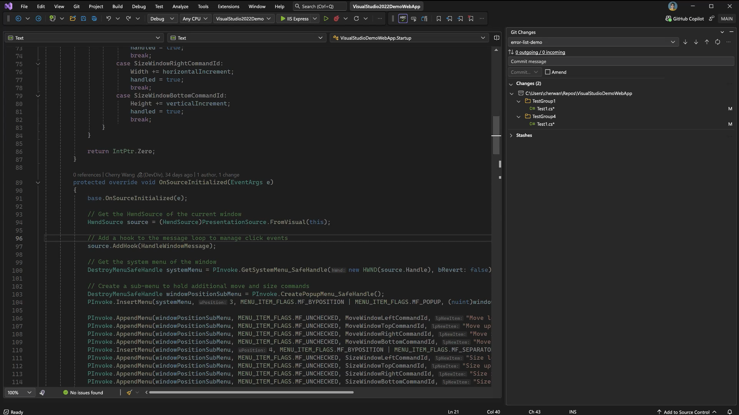
Visual Studio 2022 v17.12
Released
Upgraded GitHub Copilot experience
Modern development for .NET 9 and .NET Aspire
More user-requested features than ever before
Available today: visualstudio.com/download

Slide 54
.NET Aspire
AI + .NET
.NET MAUI
ASP.NET Core
Developer Productivity

Slide 55

ASP.NET Core Security Diagnostics | Blazor Authentication Enhancements | Tensor Primitives | AI Tokenizers | Binary Formatter removal | Microsoft. Extensions.AI | C# 13 | Enhanced Metrics | HybridCache
Azure Container App Production Diagnostics | Virtual Exceptions | Optimized Static Web Asset Handling | Adaptive Garbage Collection | Persistent Containers | Simplified Acquisition | Workload History | “WaitFor” Resources to Spin Up
Refreshed Build Output Highlighting | dotnet restore Auditing | New & Refreshed UI Controls | Microsoft Learn Training | Android 35 & iOS 18 Support | Trimming Enhancements | .NET Aspire Community Toolkit | F# 9 | ARM Performance
with ref struct Improvements | Up to 30% Faster Blazor Startup | EF Core Support for CosmosDB | Server-sent Events Parser | SDKs for Vector Databases | Visual Studio & C# Dev Kit Enhancements | Enhanced Native AOT for EF Core | CollectionView & CarouselView Performance Improvements

Slide 56
Your Windows Apps on .NET 9
Performance
Accessibility
Modern OS Features
Latest Language Features
Improved Tooling
Developer
Productivity
Native AOT support WebView2 via NuGet Package Deployment APIs
microsoft / Microsoft-ui-xaml
microsoft / WindowsAppSDK
Fluent UI Theming Theme Mode Accent Colors Hyphen based ligatures
dotnet / wpf
APIs for modern icons Control.InvokeAsync Dark Mode
dotnet / winforms
WinUI 3
WPF
WinForms

Slide 57

Get Modern & Stay Modern
“We can now rapidly develop prototypes in Python and .NET and securely deploy them at scale”– Melba Swapna, Cloud Architect Manager
.NET Upgrade Assistant
aka.ms/upgrade-assistant
Azure Migrate: application & code assessment
aka.ms/appcat

Slide 58

Scale with Azure Ready for .NET 9
Check service announcements for full availability.

Slide 59



Get .NET 9
aka.ms/get-dotnet-9
visualstudio.com/download
Learn and get certified
aka.ms/csharp-certification
aka.ms/aspire-credential
.NET 9 and Visual Studio 2022 updates available today

Slide 60
Thank you!

